Slide 1
Tiny Machine Learning

Slide 2
Topics
Definition
Context
Challenges

Slide 3
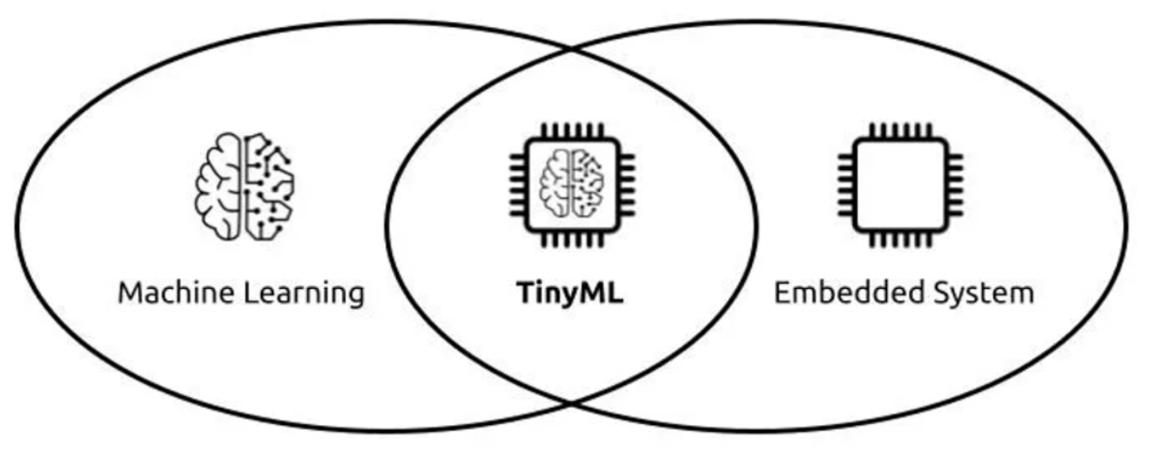
Definition

Slide 4
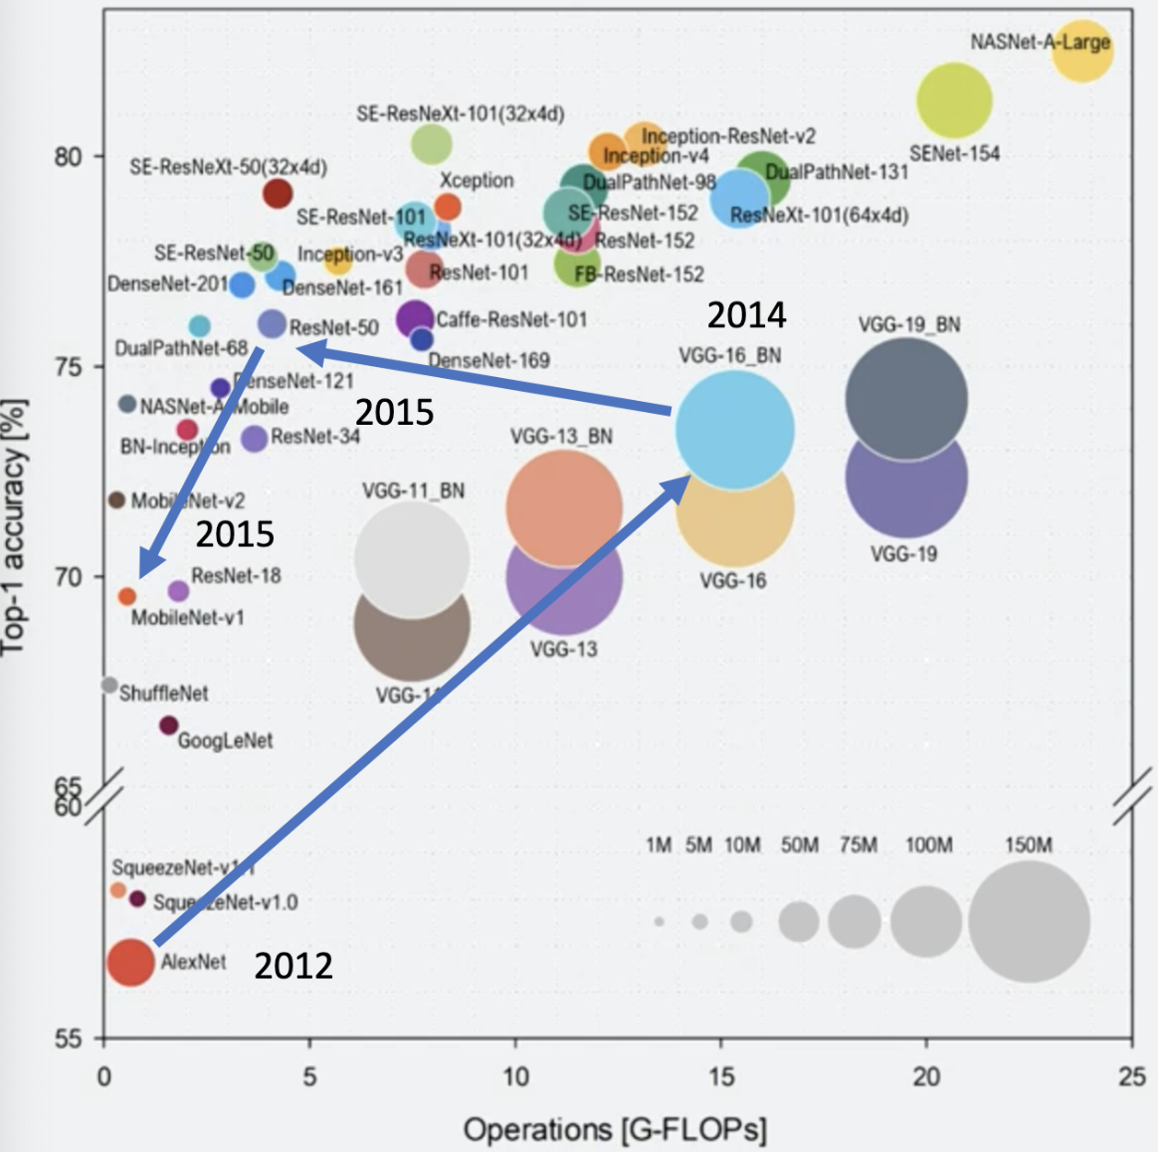
Context

Slide 5
Challenges
Devices
limited memory
low computation power
Models
huge memory requirements
to store the input data, weight parameters and activations of the network
massive amount of computations
required for the calculation of the weighted sums of the neurons inputs
ML models are typically trained using 32-bit floating-point data
fp arithmetic is very expensive (area, performance, energy) to implement in hardware
32 bits of precision is needed during training to capture very small gradient steps
it is usually unnecessary during inference
Quantization
converting signed single precision floating point (float32) to lower precision number format such as unsigned 8-bit integer (uint8)
reduce memory needed, speed up the inference

Slide 6
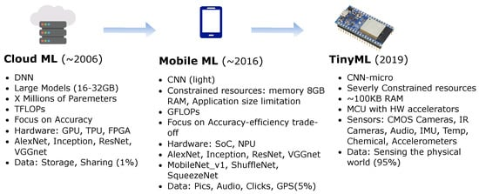
ML, Embedded ML, Tiny ML

